Slide 1
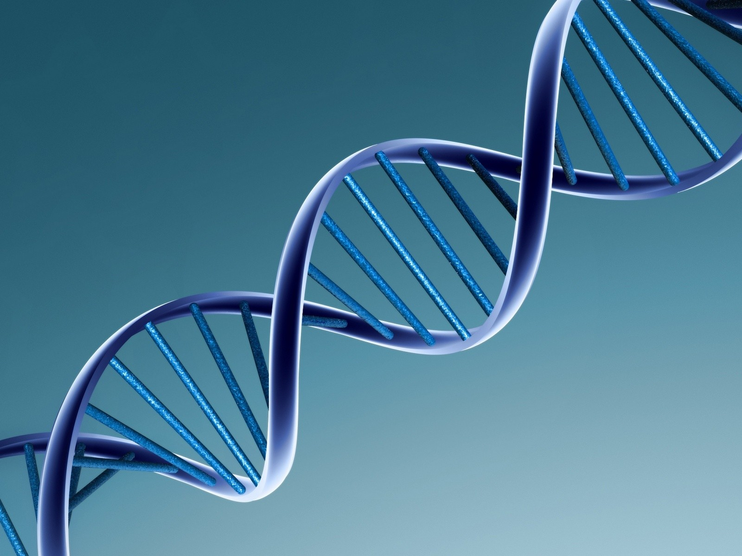
An Introduction to Cancer Genetics for Healthcare Interpreters
Cynthia Roat, MPH; Galen Joseph, PhD
Claudia Guerra MSW; Janice Cheng, PhD Robin Lee, LCGC; Karlena Lara-Otero, PhD;
Notes:
Show this slide as participants enter and are seated, and as you do your introduction and review logistics for the morning.
We’re going to start out today with some information about cancer genetics. Some of this may be new, some of this may be review, but hopefully it will be helpful to you either way.

Slide 2
What will you learn?
At the end of this presentation, you’ll have a clear understanding of:
Basic concepts in genetics
The value of genetic testing
The work of a genetic counselor
What to expect in a cancer genetic counseling session
Notes:
So, what are we going to learn today? Well, this is what we’re aiming for. (click)
At the end of this presentation, you’ll have a clear understanding of: (click)
Basic concepts in genetics (click)
Genetic testing (click)
What genetic counselors do (click)
And what to expect when you go to interpret for an appointment with a genetic counselor (click)

Slide 3
What is “genetics”?
Genetics is the study of heredity, the process of parents biologically passing particular traits to their children.
Notes:
Let’s start at the beginning – what is “genetics” anyway? When you hear the word "genetics" what comes to mind? If you can say one or two words you associate with genetics, what would they be? (Elicit a few comments.)
One definition says that (click) genetics is the study of heredity, which is the process of parents biologically passing particular traits to their children.
So what could be a trait that a parent could pass on to a child? (Elicit some traits that could be inherited.)
Right! Among other things, a person's appearance -- height, hair color, skin color, and eye color -- is determined by genetics, and, of particular interest for this presentation, the likelihood of getting certain diseases.
(click)

Slide 4
Where is genetics discussed?
Notes:
As an interpreter, you’ll encounter discussions about genetics in three major clinical areas, and occasionally in others as well.
First is prenatal genetic counseling – that’s this red section. How many of you have ever interpreted for pre-natal genetic counseling? In this field, genetic counselors work with individuals, couples, or families who have an increased chance of having a child with a birth defect or genetic condition. Those who are already pregnant or are considering having a child in the future can learn more about the condition in question, understand their risks more clearly, and discuss options for prenatal screening, testing, and/or assisted reproduction techniques such as sperm and egg donation. During pregnancy, if a baby is found to have a birth defect or genetic condition , the counselor will help the expecting couple understand the medical information, what to expect, and how to prepare for the birth of a child with special needs, as well as discuss options such as pregnancy termination or adoption.
The second most common area is cancer genetics – this section in yellow.
Genetic counselors will work with individuals who have or have had cancer, or who have family members who have developed cancer at a young age, to determine if there is any genetic predisposition to cancer.
Then there is pediatrics, or general genetics – this green section. General genetics clinics serve children, adults, and families with known or suspected genetic conditions and birth defects. A team of physicians and genetic counselors are available to diagnose and provide support and help for those with any genetic condition.
Genetics is also discussed in other specialty clinics. (If students ask which, mention cardiology and metabolics.)
(click)

Slide 5
Genetics and Environment
Environmental Cause
Genetic Cause
Why do I have this medical problem?
Multifactorial Cause
(genes plus environment)
Notes:
Genetics and the environment interact in complex ways to cause sickness. (click)
Some medical conditions are caused entirely by the environment – for example, anyone exposed to enough radiation will get radiation sickness, regardless of their genetic make-up. (click)
And some conditions are 100% caused by genetics. For example, everyone who has a third 21st chromosome will have Down Syndrome, regardless of where they grew up or what sort of environmental risks that person was or wasn’t exposed to.
(click)
But many medical conditions are known to be caused by genetic AND environmental factors. We say that such conditions have “multifactorial causes.” While it is difficult to know for certain what caused a disease, it is fair to say that both the genes you were born with and environmental factors (diet, physical activity, exposure to chemicals etc) interact together and influence risk for disease.
(click)

Slide 6
https://public.ornl.gov/site/gallery/detail.cfm?id=396
Notes:
But how do genetics impact your body? Let’s go inside the body, down to the most microscopic level, to see how it works.
Let’s start at the cellular level. Who can tell me what a cell is? (Elicit some ideas from the group.) Good! Basically, cells are the building blocks that make up our bodies, and different cells have different functions. Inside the cell are lots of structures that allow it to fulfill its particular function, to process energy, to get rid of waste, and to reproduce.
But how does the cell know what its particular function is? And how do cells know how to work together. This is all programmed into the cell’s DNA.
Every cell in your body (with the exception of red blood cells) carries your DNA. DNA can be thought of as the instructions that our bodies use to grow, develop and function. Your DNA is packaged into units called chromosomes. A chromosome is made up of many genes which are individual sections of DNA that code for a specific trait/function.
All these technical terms are defined in the glossary.
(click)

Slide 7
How is genetic information passed on?
Humans have 23 pairs of chromosomes in every cell.
The egg and sperm are special; they have only one of each chromosome.
When an egg and sperm come together, they grow into a child who has two of each chromosome: one from Mom, and one from Dad.
http://www.daviddarling.info/childrens_encyclopedia/Genetic_Engineering_Chapter1.html
Notes:
We each receive half our DNA from our mother and half from our father. Here’s how it works.
In each cell, we have 23 pairs of chromosomes. The egg and the sperm are special. Instead of having a pair (that is, two) of each chromosome, they have only one of each chromosome. When the sperm fertilizes the egg, each chromosome from the father joins the matching chromosome from the mother, and now the fertilized egg has, again 46 chromosomes – 23 pairs.
(click)

Slide 8
Summary & Questions
What is genetics?
Heredity
Where might you encounter genetics in the course of your work?
What are genes? DNA? Chromosomes?
Notes:
So far we have gone over some basic information about genetics. (click)
So, what is genetics? (wait for a response) Right – it’s the study of heredity. (click)
And what is heredity? (wait for response) It’s the process of parents biologically passing particular traits to their children. (click)
Where might you encounter discussions of genetics in your interpreting work? (wait for response) Right! Pediatrics, Pre-natal care, and oncology, as well as some others. (click)
And finally, what are genes? (wait for response) Chromosomes? And DNA? Yes, this is confusing. All these terms describe the genetic material that carries traits from one generation to another. So, genes are the basic unit of heredity, meaning that every trait we inherit from our parents is stored in genes. DNA is the molecule that contains our genes. And DNA is organized into chromosomes. (click)

Slide 9
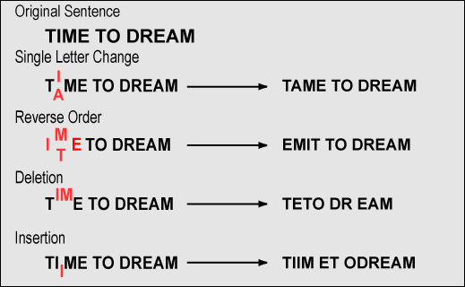
Mutation
http://www.koshland-science-museum.org/exhibitdna/inh03.jsp
Notes:
So, a gene can be thought of as a long string of letters that determine a particular trait – like hair color - or that tell the cell to perform a certain function. And when the cell reproduces, the DNA reproduces too, so the new cell has exactly the same genes as the original.
But sometimes, during the process of duplicating itself, there is an error. This is called a mutation.
A mutation can be thought of as a change in the sequence of letters from what is expected. This can happen in many ways. A single letter can be changed, there can be a mix up to the order of the letters, some letters can be deleted or some letters can be added. Any of these changes has the potential to disrupt the function of the gene causing it not to work.
And as the cell reproduces itself, now this mutation is carried on to new cells. When the individual has children, the mutation can be passed onto them.
(click)

Slide 10
Do all mutations cause illness?
NO!
Some changes are BENIGN (they cause no harm).
But some are CLINICALLY SIGNIFICANT (they cause a problem)
Notes:
So do all mutations cause illness? (click)
No! (click)
Some changes are benign – that means that they cause no harm.
But others are clinically significant – that means that they cause a problem. Genetic counselors refer to these mutations as “deleterious. ”
And some changes can lead to a higher risk of cancer. (click)

Slide 11
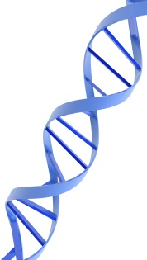
Do mutations cause cancer?
IT DEPENDS.
Sporadic cancer = environmental causes alone or random mutations that occur with aging
Hereditary cancer = Genetics alone or environment interacting with genetics.
Notes:
So let’s talk about cancer for a minute. Who can tell me what cancer is? (Elicit some ideas about what cancer is – not what causes it, but what it is.)
Cancer is a condition in which abnormal cells start to reproduce in an uncontrolled way. (click)
Cancer can be caused by exposure to environmental factors, like – what? What are some environmental factors that can cause cancer? (Elicit some causes of cancer – chemical exposure, smoking, etc.) Or cancer can be caused by random mutations that accumulate with the passing of time in certain cells of one individual, and that cannot be passed on to children. Cancer that is caused entirely by environmental factors or random mutations like this is called sporadic cancer. (click)
But in some people, mutations to certain genes make it more likely that they will get cancer. These genes can be – you guessed it – passed down to their children, who will also be more likely to get cancer. This is called hereditary cancer.
Most cancer is sporadic, not hereditary. Hereditary cancer accounts for only about 10% or 1 out of 10 cancers. (click)

Slide 12
So hereditary cancer . . .
Happens more often than would be expected by chance
For example, in many generations
Happens at a younger age (under age 50)
Is more likely to be bilateral in paired organs
For example, in both breasts
Notes:
Let’s do a little review.
DNA contains the genetic information that tells our cells how to function and how to reproduce. We get half our DNA from our Moms and half from our Dads. Changes, or mutations, in the DNA can be benign, or they can cause illness. Some mutations can increase our chances of getting cancer – and this is called hereditary cancer.
And we can sometimes tell that a cancer is hereditary because (click) it happens more often that would be expected by chance, for example, in more than one generation on one side of the family.
(click) It happens earlier in life (usually before age 50), and
(click) It is more likely to be bilateral in paired organs -- so for example, it appears in BOTH BREASTS.
Remember, the vast majority of cancer is NOT hereditary! Only about 10% of cancer can be explained by a genetic mutation that gets passed down in families. For example – a heavy smoker (a known risk factor for lung cancer) that develops lung cancer in his 80’s (later in life) does not make us think of a hereditary cause for his cancer, while a young woman with breast cancer at age 38 is a history more suggestive of a genetic predisposition.
(click)

Slide 13
Other key concepts
Metastasis – the original cancer spreads to other organs
Recurrence – the original cancer returns after treatment and a period of time when the cancer cannot be detected
Second primary cancer – a completely different cancer starts after the first is treated
Notes:
Here are some other key concepts that you might hear as you interpret in cancer genetics.
(click) Metastasis means that the original cancer has spread from one organ to another.
(click) Recurrence – the original cancer returns after treatment and a period of time when the cancer cannot be detected.
(click) A second primary cancer is a completely different cancer that starts up independently from the first cancer. This would be, for example, getting breast cancer after you were already treated for ovarian cancer. People with hereditary cancer get more second primary cancers.
(click)

Slide 14
Summary & Questions?
What is a mutation?
What does it mean that a mutation is “benign” or “clinically significant”?
What does “deleterious” mean?
What is the difference between sporadic and hereditary cancer?
What are some signs (sometimes called “red flags”) of hereditary cancer?
Notes:
Another quick review!
What‘s a mutation? (wait for responses) Right! A mutation is a change in a gene. (click)
What does it mean that a mutation is “benign?” (wait for responses) Right – that it’s not worrisome, that it won’t lead to cancer.
How about if it is “clinically significant?” (wait for responses) Right – that means that the mutation creates a greater change of getting cancer. (click)
What about if the mutation is “deleterious?” (wait for responses) Right! The same thing as “clinically significant.” (click)
What is sporadic cancer? (wait for responses) Cancer that is NOT linked to an inherited genetic mutation. (click) What is hereditary cancer? (wait for responses) Cancer that IS linked to an inherited genetic mutation. (click)
What are some of the “red flags” or signs of hereditary cancer? (wait for responses) Here are some: cancer at a young age, a lot of cancer in the family, cancer in multiple generations, cancer that occurs bilaterally.
OK. So what happens when a doctor sees some of these red flags? Where might she refer the patient? Right! To genetic counseling. So let’s talk a bit about what genetic counseling is all about and what genetic counselors do.
(click)

Slide 15
What is genetic counseling?
“Genetic counseling is the process of helping people understand and adapt to the medical, psychological and familial implications of genetic contributions to disease.”
The National Society of Genetic Counselors
www.nsgc.org
Notes:
When a patient is diagnosed with cancer and there is a suspicion that this cancer may be inherited, that patient will be referred to genetic counseling. Also, patients with a strong family history of cancer, but who haven’t been diagnosed with cancer themselves may be referred to see a genetic counselor.
So what is genetic counseling?
Can somebody read us the definition from The National Society of Genetic Counselors? (Have someone read the definition on the slide.)
(click)

Slide 16
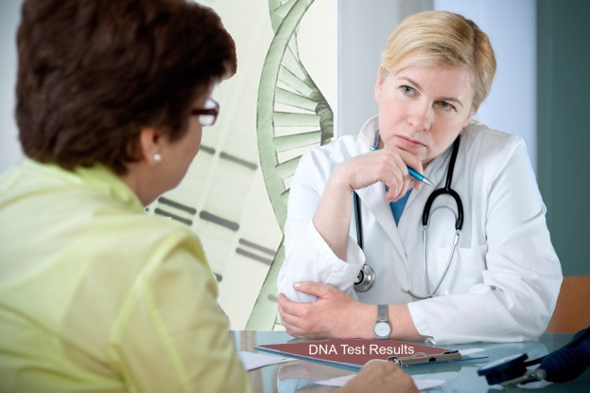
What do genetic counselors do?
Educate
Gather Family History Information
Counsel & Support
Notes:
And what do genetic counselors do, in the process of helping people understand and adapt?
(click) One thing that genetic counselors do is to help patients and families understand what genetics is.
(click) They also assess an individual’s risk for certain diseases, such as breast cancer. To do this, they gather information about the patient and the family. This could be through:
– Medical records of patient and other family members,
– Through obtaining a health, medical, and developmental history,
– And by constructing a pedigree (i.e., family history).
(click) and of course, they provide support to the family, helping them handle:
– the normal grief responses of the patient and parents,
– the emotional responses of family members, such as shock, disbelief, relief, fear, guilt, sadness, shame, acceptance.
They help them think about how to share information with others, especially family members who may be at risk. And, they provide written materials and referrals to support groups and care providers, other families with the same or similar conditions, and local and national service agencies.
(click)

Slide 17
What to expect at a cancer genetics appointment
1st appointment:
Gathering information on family history of illness
Education on genetics, cancer, risk and risk reduction
Genetic testing if appropriate and desired
2nd appointment:
Test results & counseling
Notes:
When you interpret for an appointment in cancer genetics, it may help to have an idea of what to expect.
(click) The first appointment with the counselor will be taken up with some basic education on cancer genetics, and on gathering information on the family’s history of illness. The main purpose is to assess the patient’s risk of hereditary cancer – that is, does it seem likely that cancer is running in the family? This will suggest whether genetic testing is appropriate.
If the patient agrees, the genetic counselor will review the consent for testing and take a blood or saliva sample for genetic testing. We’ll talk more about that in a bit.
(click) And at the second appointment, the genetic counselor will go over the test results and provide counseling.
Let’s look at each of these more carefully. Since you are now all experts in basic genetics (ho, ho, ho), we’ll start with a technique that genetic counselors use to gather information on a patient’s family history. This is called a pedigree.
(click)

Slide 18
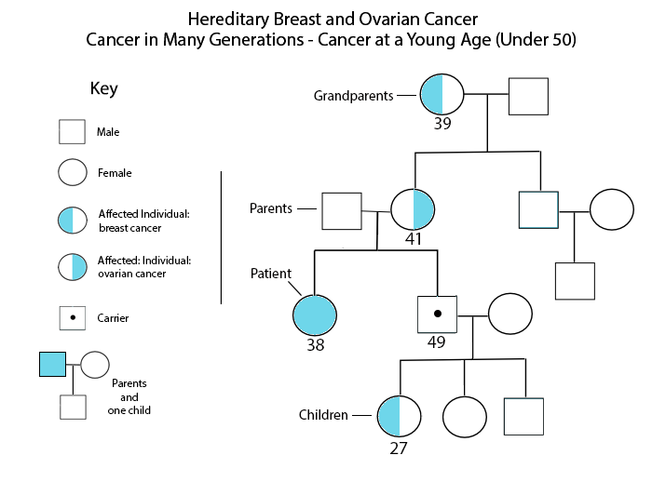
Notes:
Here’s what a picture of a pedigree, or “family tree” might look like. As you can see, a pedigree is a very visual tool for showing the pattern of cancer – or any suspected disease – in a family. You don’t need to know how to read one of these, but we thought you might be interested in seeing one.
Circles represent females. Squares represent males. The shaded individuals represent those who are affected with the condition in question. So let’s read this pedigree. Let’s say that the patient’s name is Maria. She is pictured in the blue circle. She has been diagnosed with breast and ovarian cancer at the age of 38 – that’s early!! It is also significant that she has two primary cancers in different organs in her body. She was referred by her doctor to see a genetic counselor. As you can see here, on her mother’s side there are several relatives affected with cancer, including their mother diagnosed with ovarian cancer at age 41 and their maternal grandmother diagnosed at age 39 with breast cancer. Both diagnoses were at a very young age!
The genetic counselor offered her a test for the BRCA genes, and she tested positive. Then the counselor offered her brother Francisco testing too. Her brother Francisco is pictured with the white square with the dot in the center. The dot means that Francisco is a carrier for a mutation. He tested positive too. Carriers are not affected, even though they themselves have inherited the mutation. However, by being a carrier, Francisco has an increased risk of developing breast cancer (yes, men can get breast cancer). Look at Francisco’s daughter; she also has breast cancer. She was diagnosed at age 27. She also tested positive for the genetic mutation.
Anyone with a mutation can pass it on to their children, even if they do not have cancer. So each of Francisco’s children has a 50/50 or 1 in 2 chance of inheriting Francisco’s mutation. (click)

Slide 19
Challenges Constructing a Family Tree
“I don’t know what he died of.”
“I know it was cancer, but I don’t know what kind.”
“I don’t know how old she was when she was diagnosed.”
Notes:
Many patients, however, encounter real challenges in helping a genetic counselor construct an accurate family tree or “pedigree”. Can you guess what some of them might be? (Elicit some ideas from the group.)
(click) Often, people don’t know an exact cause of death for their relatives.
(click) They may know that the relative was sick, but not know an exact diagnosis or (click) how old the person was when diagnosed.
Nevertheless, a pedigree is a major tool used by genetic counselors to help evaluate a family’s risk for a hereditary condition. It is so important, that the genetic counselor may ask the patient to go home and try to find out the information of which he or she is unsure.
If the pedigree indicates that there may be a genetic component to illness in the family, the genetic counselor will offer the patient the opportunity to have a genetic test.
(click)

Slide 20
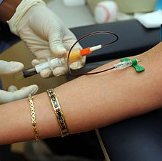
What is Genetic Testing?
From a blood or saliva sample, the laboratory looks at a patient’s actual genetic structure.
IDENTIFIES
CANCER RISK – NOT CANCER
Notes:
So, what is genetic testing all about?
Genetic testing examines the patient’s actual genetic structure. This is done by isolating DNA from the patient’s blood, or from the patient’s saliva.
In the case of cancer, genetic tests help identify a person’s risk of developing cancer. Please note this well – genetic testing does not identify whether a person HAS cancer. It identifies what genetic changes a person may have that create a HIGHER RISK than most people have for getting certain cancers.
Cancer risk may also be called “cancer predisposition” or “predisposition to cancer.”
For individuals who have already been diagnosed with cancer, genetic testing can explain why the person got cancer (heredity or environment), and can indicate the risk of a second primary cancer. For example, if the person already has breast cancer and tests positive for a mutation, that may indicate a higher risk for ovarian cancer.
(click)

Slide 21
Genetic Testing
Looks at multiple genes in one test (a select “panel” of genes, also known as multi-gene testing)
May get information about risk of several different cancers
Each gene has a name made up of letters and numbers, like BRCA1, PALB2, CDH1
No single test yet for all cancer risk
Notes:
Much of the genetic testing done today is something called “panel testing” or “multi-gene testing.”
(click) This means that the test examines many genes at one time that are associated with the risk for different kinds of cancers.
(click) So, with one test, the genetic counselor can get information on the risk for multiple cancers.
(click) Each gene has a name made up of letters and number, such as BRCA1 or BCRA2.
(click) Unfortunately, there are no tests yet to identify all cancer risk.
It is not important for you to learn every gene and the cancers it is associated with. As we learn about the genetics of illness, more genes are added to the panel tests.
(click)

Slide 22
Why do Genetic Testing?
Know cancer risk
Identify whether other family member might be at high risk for developing cancer.
Early detection
Earlier and more frequent screening
Better treatment
Treatment could begin earlier, which might lead, for example, to a lumpectomy instead of mastectomy.
Prevention
Prophylactic mastectomy and oophorectomy
Hormonal treatments (Tamoxifen, birth control pills)
More aggressive follow-up of suggestive screening results
Colonoscopy
Notes:
So we know what genetic tests can tell us. But – so what? If someone’s going to get cancer, there’s nothing they can do about it, right? What does it matter?
It actually does matter.
Genetic testing will help identify whether the patient and other family members are at high risk for developing cancer. If they are, then there are steps they can take to help reduce that risk.
Let’s say, for example, that a woman knows that she has a genetic predisposition for developing breast cancer. She and her doctor might decide to start getting mammograms earlier and more frequently than most women.
If there were a suspicious result on a mammogram, her doctors might do aggressive follow-up rather than waiting to see what happened.
This earlier screening could allow doctors to catch a developing cancer much earlier, for example enabling the woman to get a lumpectomy instead of a mastectomy.
In some cases, doctors might recommend measures to prevent the cancer in question, such as removal of the organ before cancer develops or hormonal treatments.
These are some of the ways in which the information from genetic testing can help a patient and his or her family. (click)
(click)

Slide 23
Why are some people hesitant?
“It would shame my parents to think that it is their fault that I got cancer.”
“If my family finds out I have a genetic mutation, they’ll treat me differently.”
“What difference would it make?”
“It will just make me worry.
Notes:
Regardless of how helpful it can be, some people are hesitant to get genetic testing. Why? Can you think of some possible reasons? (Elicit reasons from the group.)
Here are some reasons that the genetic counselors at the University of California at San Francisco have heard:
(click) Some people feel that knowing they have an elevated risk for cancer will just make them worry about it.
(click) In some cultures, it would be shameful for parents if they thought they had passed on a gene that caused their child to get cancer.
(click) People may feel that if they’re going to get cancer, there’s nothing they can do about it, so it doesn’t help to know they are at higher risk.
(click) Some believe that if it is known that they have a genetic mutation, their family will treat them differently.
There is also sometimes a belief that cancer is a punishment for something that the patient has done, and some patients even fear that the testing itself will cause cancer.
Genetic counselors listen to all these concerns seriously and discuss them with the patient. Your job is to make sure that all these concerns get communicated accurately and completely. If there are cultural aspects to the issues that come up, you should point these out so that the genetic counselor can ask more about them.
If a patient decides to go ahead with genetic testing, the first step is giving informed consent.
(click)

Slide 24
Summary & Questions
What genetic counselors do?
What is genetic testing?
What is panel testing?
Why would someone want to do genetic testing?
And why might someone NOT want to do genetic testing?
Notes:
OK, quick review!
What do genetic counselors do? (wait for responses) Gather information, educate, counsel and support. (click)
What is genetic testing? What’s it looking for? (wait for responses) Testing to identify inherited gene mutations or changes in a gene that can cause problems. (click)
What’s panel testing, also known as “multi-gene testing.” (wait for responses) Panel testing is genetic testing that looks at multiple genes at once. (click)
Why would someone want to get genetic testing? (wait for responses) To identify potential increased risk for cancer in self or family, so as to take preventive measures. (click)
Why would someone choose not to get tested? (wait for responses) Concerns about worry, family response, societal response, etc. (click)

Slide 25
Why does genetic testing require informed consent?
GT is not research, but consent is required just as it would be for other procedures.
GT may cause anxiety, the results may impact family dynamics, positive results may cause sense of guilt.
Notes:
Genetic testing is like any other medical procedure, and like any other procedure, it requires informed consent. This is especially true since testing can cause anxiety, the results can have implications for family members’ health, not just the patient’s health, and positive results can cause a sense of guilt if patients feel responsible for passing “bad genes” down to their children.

Slide 26
“Can you just read this form to the patient?”
NO!
CALL Model for Deciding When to Sight Translate
Don’t sight translate a document that is:
Complex
Advanced
Legal, or
Long
How to say no politely.
Recognize the validity of the requestor’s goal.
Offer options.
Give reasons.
Bancroft, et al. The Community Interpreter International, 2015
Notes:
As interpreters, we are often caught in a real bind regarding informed consent. Have any of you ever been handed a consent form and asked “Can you just read this form to the patient and have him sign?” So, can we do that?
(click) NO! Why is this a bad idea?
And why do we feel pressured to do it anyway?
We need to resist! Remember, informed consent is a process, not a piece of paper.
Marjory Bancroft, in The Community Interpreter, introduces an acronym for times like these: C-A-L-L. (click) “Don’t do a sight translation if the document is: Complex, Advanced, Legal, or Long.” And consent forms are always legal documents.
But how do we say no without getting in trouble? Marjory has a simple process for that as well. (click)
Recognize the validity of the requestor’s goal. e.g. “Yes, we definitely need to make sure that the patient gives informed consent.”
Offer options. e.g. “ I would be happy to interpret for you if you’d like to do an oral consent, or we can check to see if this consent form is available in Cantonese.”
Give reasons. e.g. “I want to make sure the patient can ask questions and really understands what she is signing.”
The best scenario is that the genetic counselor will explain the consent form orally, and have you interpret that. Once all the patient’s questions have been answered and consent has been given, the patient will have blood drawn or saliva collected, and be given an appointment to follow-up with the genetic counselor when the test results are back.
(click)

Slide 27
Genetic Test Results
Positive – a deleterious mutation is found; the mutation causes an increased risk of certain cancers
Negative – no mutation is found in any of the genes tested
Variant of Uncertain Significance (VUS) – a mutation was found, but scientists don’t know yet whether it causes harm or is benign.
Notes:
The test results are back. What might they show?
For any genetic test, there are 3 possible test results: positive, negative and variant of uncertain significance. Wow, that’s a mouthful!
(click) A positive result means that a mutation was found. Not just any mutation, but a “deleterious mutation”, which means that it’s a mutation that can cause problems.
(click) A negative result means that no mutation was found in any of the genes tested.
(click) And this last one – a Variant of Uncertain Significance or VUS -- can be confusing. It basically means that the test found a mutation, but we don’t have enough knowledge or evidence yet to know if it causes harm or if it is a benign change. Usually this uncertain result will be resolved within a few years, and the patient will be notified.
(click)

Slide 28
Test Results: Common Syndromes
Syndrome
Associated Cancers
Hereditary Breast
and Ovarian Cancer (HBOC)
Lynch Syndrome
Breast and ovarian
Colon, rectal, uterine, ovarian
Notes:
Now here’s something interesting. You might think that a mutation in one specific gene leads to higher risk of one specific cancer. Or maybe a higher risk of ALL cancer. But in fact, particular gene mutations are linked to a higher risk of a particular group of cancers that kind of go together. These are called “syndromes.”
So, for example,
(click) Mutations of the genes BRCA1 and BRCA2 lead to a syndrome called HBOC (Hereditary Breast and Ovarian Cancer). These genes have the job of suppressing tumors. When they mutate, they don’t work correctly, increasing the chance that the patient will develop certain cancers, specifically breast and ovarian cancers.
(click) On the other hand, mutations in the genes MLH1, MSH2, MSH6, PMS2 lead to increased risk of cancer in the colon, rectum, uterus, and ovaries. This is called Lynch Syndrome.
You do not need to learn all the syndromes and what cancers are involved with each. But it would be good to know the terms BRCA1, BRCA2, HBOC, and Lynch Syndrome. And remember that one mutated gene can lead to a group of cancers; this is called a hereditary cancer syndrome.
As you can see, genetic test results may be uncertain and complex, which can be hard for the patient to hear, hard for the counselor to explain, and of course, hard for the interpreter to interpret.
(click)

Slide 29
Issues in genetic counseling
Anxiety and depression
Worry about children
Family dynamics
Hard decisions
Genetic discrimination
Notes:
The final thing that genetic counselors do is provide support for families. It is not easy to hear that you have an increased risk for something like cancer, and that you may have passed it on to your child, or that although you do not, other members of your family, like your siblings or a parent, do have an increased risk.
(click) People who receive genetic testing may struggle with anxiety and depression. What will happen? Are they doomed to get cancer? Will they die young?
(click) They can be confronted with difficulties in their families, where relatives may see their mutation as somehow unnatural or where relatives of their spouse may blame them for bringing illness into the family.
(click) They may be faced with hard decisions. For example, should they have a bilateral mastectomy in order to avoid breast cancer?
(click) And they may fear genetic discrimination. Does anyone know this term? (Wait for an answer) Genetic discrimination occurs when people are treated differently by their employers or by an insurance companies because they have a gene mutation that is associated with a higher risk for some disease.
However, genetic discrimination is illegal in the U.S. In 2008, Congress passed the Genetic Information Nondiscrimination Act (GINA). This law makes it illegal for employers or health insurance companies to discriminate on the basis of genetic information. Employers may not even seek this information, and health insurance companies may not raise rates or cancel policies based on this information. The law’s definition of “genetic information” includes the family history and use of genetic services. We have a handout for you to give to you some background on GINA.
These are some of the issues that genetic counselors help patients and families deal with.
(click)

Slide 30
Summary & Questions
Basic concepts in genetics
How mutations lead to health issues
Sporadic cancer vs. hereditary cancer
Genetic counseling
Family history and pedigrees
Genetic testing
Notes:
This is about it for new information today. The rest of the class we’ll spend working with this information, with the terminology in both your target languages, and doing some practice interpretations, so that you can internalize it and operationalize it.
So, what did we talk about so far?
(click)
We went over some basic concepts in genetics: cells, chromosomes, DNA, genes
(click)
We talked about how these pass on traits from one generation to another, and how mutations in the genes can lead to health issues.
(click)
We talked about the difference between sporadic cancer (cancer that happens by chance) and hereditary cancer (cancer caused in part by mutations to specific genes).
(click)
We talked about genetic counselors and what to expect in a genetic counseling appointment.
(click)
We talked about taking a family history, and pedigrees.
(click)
We talked about genetic testing, what the tests look for, why people are sometimes hesitant to get tested and how to handle informed consent as an interpreter.
So that ‘s all the new information we’re going to introduce today. But if you’d like to learn more . . .
(click)

Slide 31
For more information, go to
NIH Talking Glossary of Genetic Terms https://www.genome.gov/Glossary/
NIH Glosario Hablado de Términos Genéticos http://www.genome.gov/GlossaryS/
FORCE (Facing Our Risk of Cancer Empowered) http://www.facingourrisk.org/understanding-brca-and-hboc/index.php
Does it Run in the Family? A Guide to Genetics and Health http://www.geneticalliance.org/sites/default/files/publicationsarchive/Book2.GA_lowlitFHHT.pdf (English, Spanish, Tagalog)
Learning Genetics, from Columbia University Medical Center http://www.learninggenetics.org/index.html
National Society of Genetic Counselors http://www.nsgc.org/
Notes:
. . . here you have some great websites where you can go and read more on genetics in general and cancer genetics in particular.
I’ll leave this up here, while I ask, are there any questions?
If not, let’s take a break. Please be back in 15 minutes.

